Slide 1





RuxaiLab
Sentiment Analysis for
Usability Tests
GSoC 2024
Meet #4: Ver.#2 Sentiment Analysis + Docker Image
Presented By: Olivia Wilson
03-07-2024 17:00 (UTC+3)

Slide 2

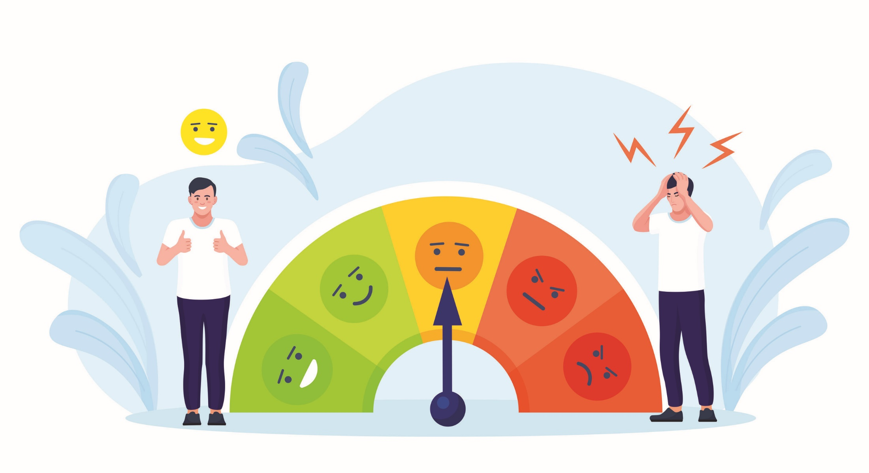
Agenda
Assembly AI
Inference Time
Subscription Plan
Whisper
Pipeline
Flask
Docker
Cloud Provider
Coding & Wikki Docs
Timeline & New Tasks
Feedback

Slide 3



Assembly AI
Issues:
Inference Time
Subscription Plan

Slide 4


Assembly AI (Inference Time)
Reasons For Large Latency:
Large size for .mp4 file
Long upload time

Slide 5
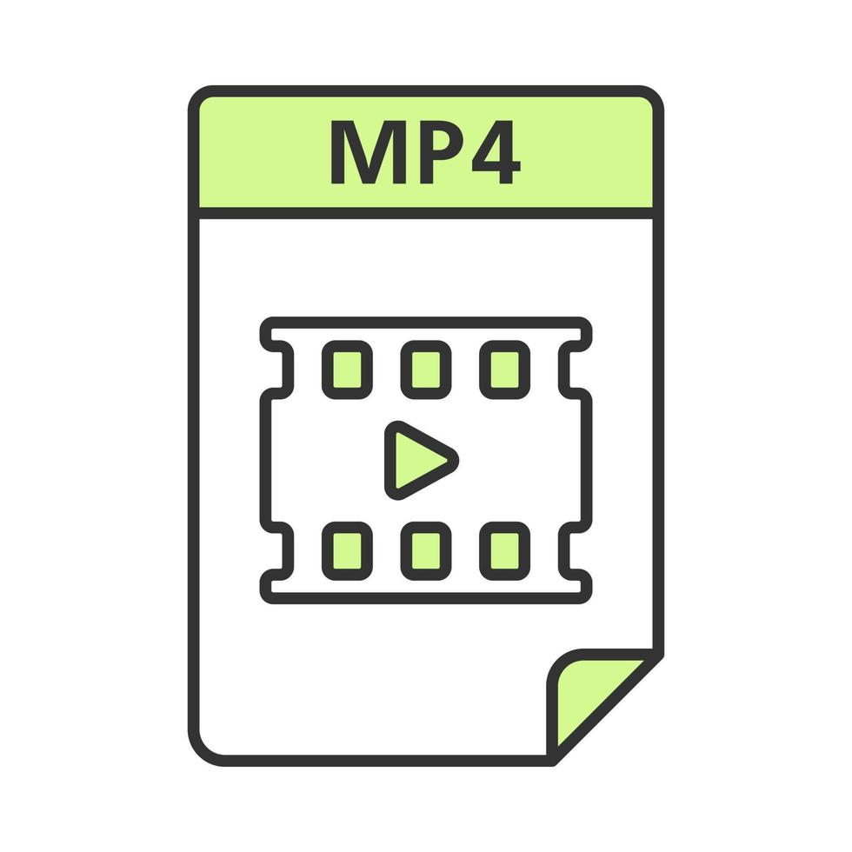
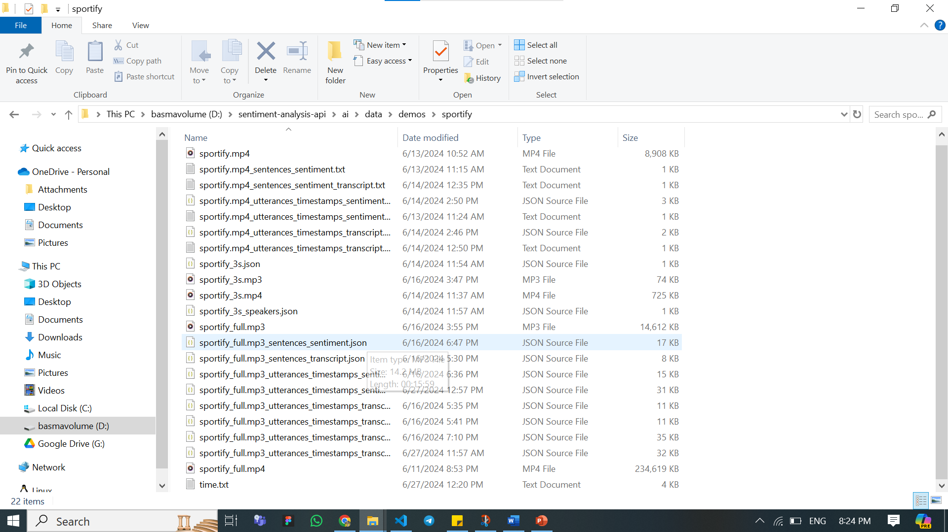

Assembly AI (Inference Time)
Issues:
Large size for .mp4 file
Long upload time
Solution:
Extract audio (.mp3) from .mp4 🡺 MoviePy

Slide 6



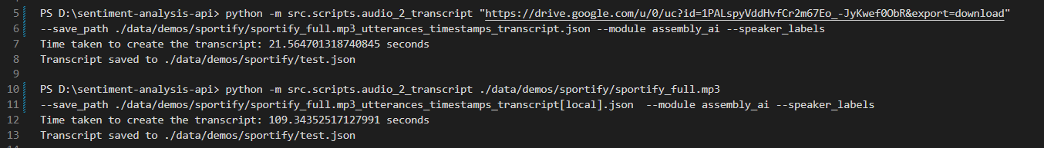
Assembly AI (Inference Time)
Issues:
Large size for .mp4 file
Long upload time
Solution:
Extract audio (.mp3) from .mp4 🡺 MoviePy
Notes:
We can use link for file from firebase

Slide 7

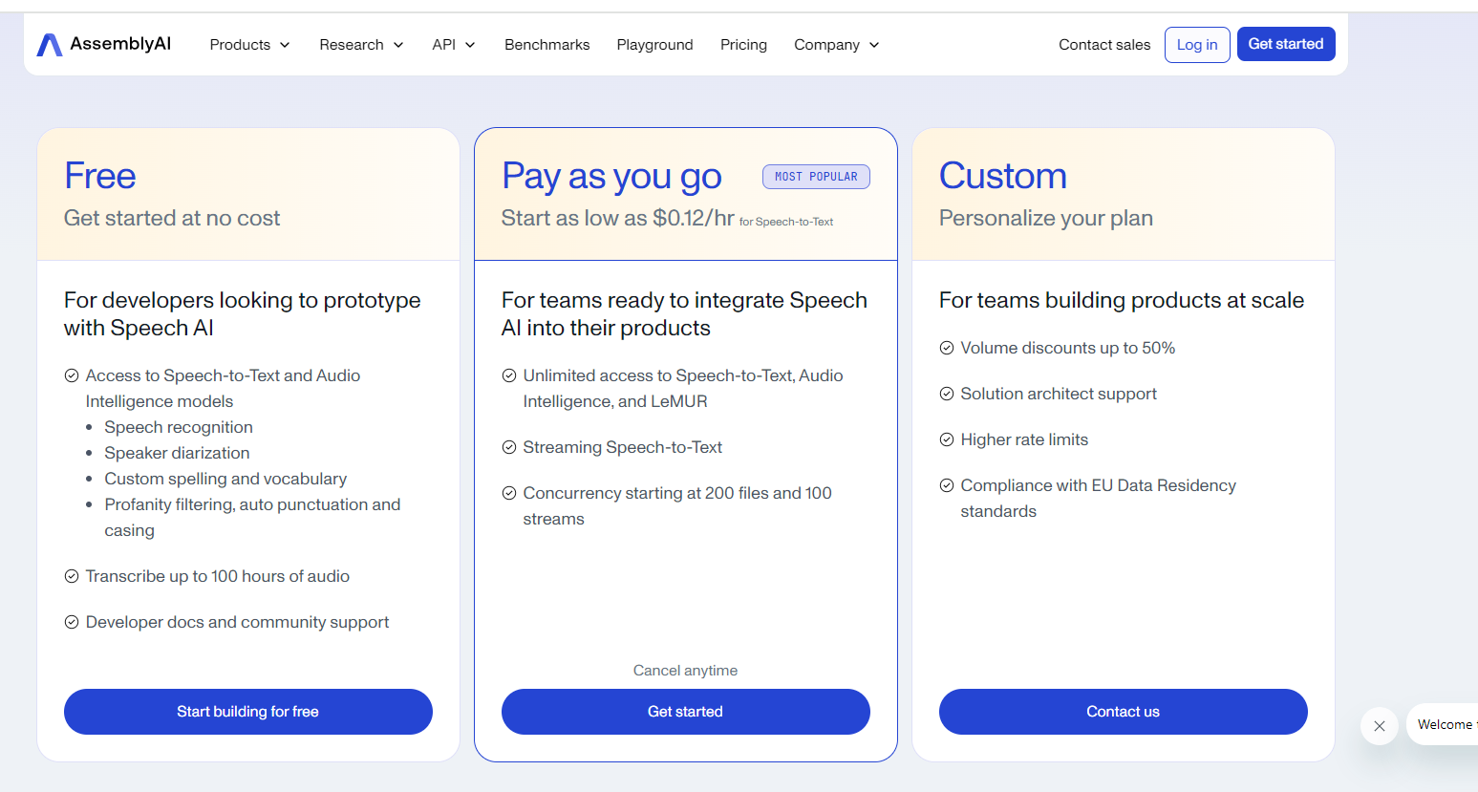
Assembly AI (Subscription Plan)
Users use their API Keys
Notes:
We can use link for file from firebase

Slide 8

Assembly AI
Limitations:
Not Open Source
Subscription Plan
Notes:
We can use link for file from firebase

Slide 9

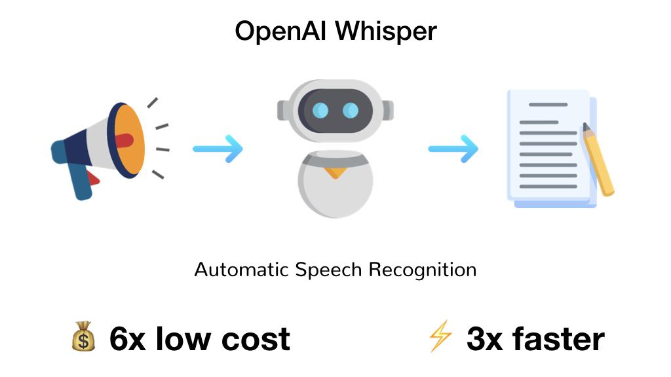
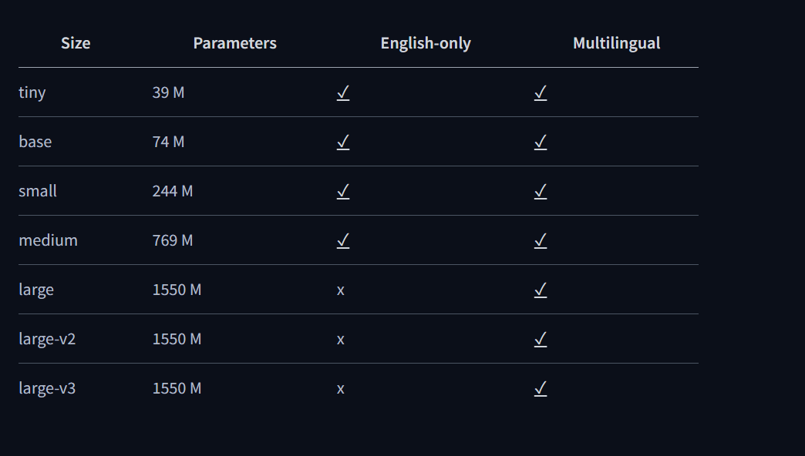


Whisper
Features:
Karine
Open Source
Pre-trained Model on Hugging Face
Different Sizes for the model
Notes:
Using our resources

Slide 10
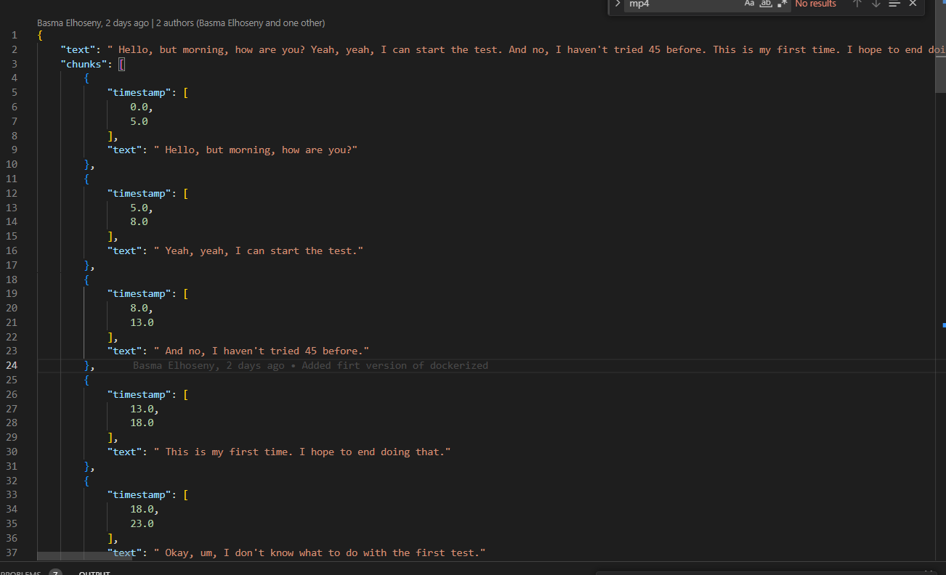
Whisper (Tiny)
Sportify

Slide 11
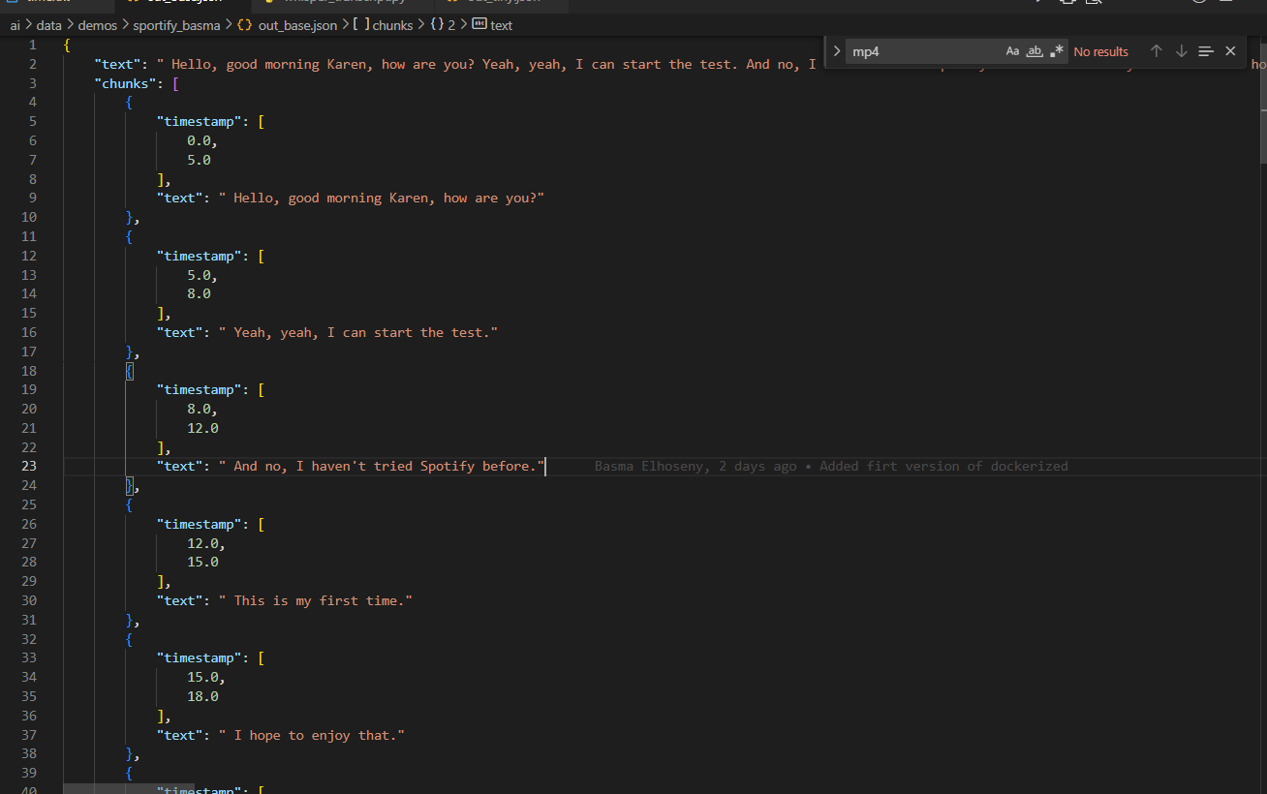

Whisper (Base)

Slide 12
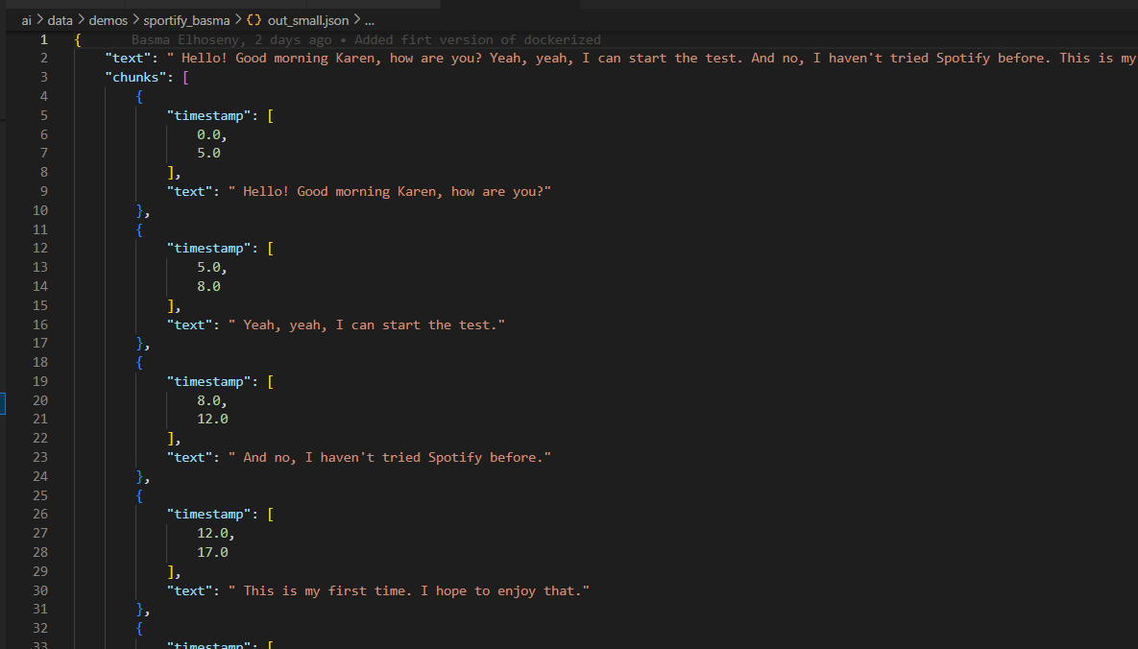
Whisper (Small)

Slide 13




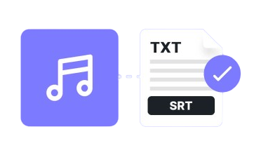
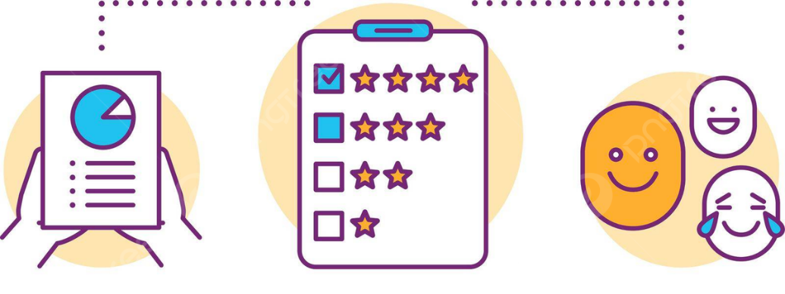

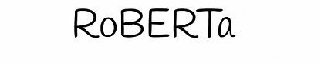
Pipeline
RuxaiLab Sentiment Analyzer
Video2Audio
Speech2Text
Sentiment Analysis

Slide 14
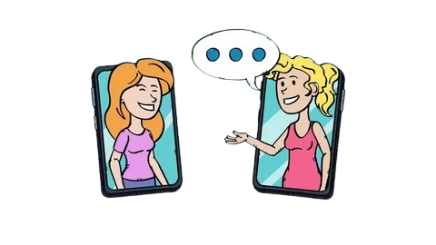
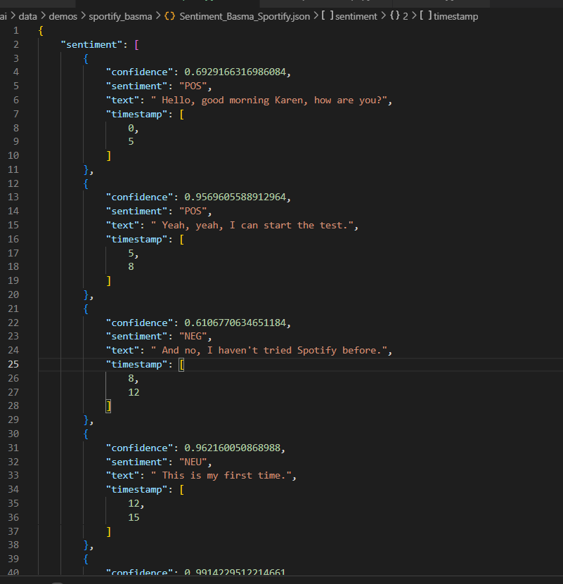

Pipeline (example)
Karine
Basma
Json File [here]

Slide 15
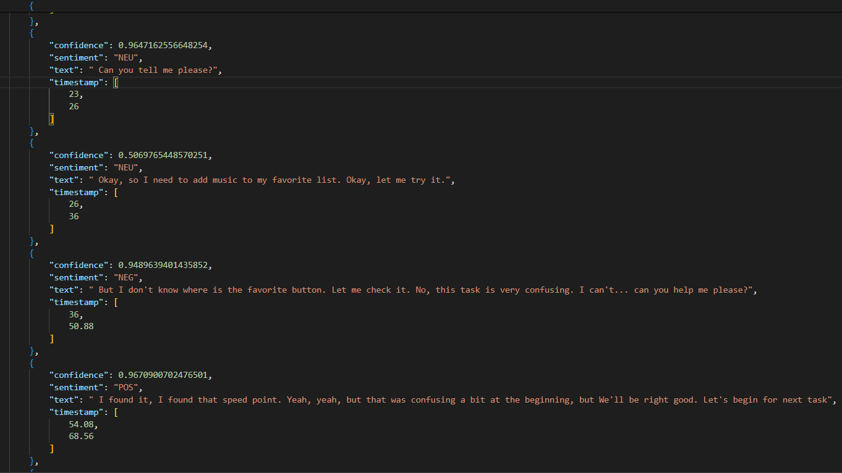
Pipeline (example)
Json File [here]

Slide 16



Flask App
Learned:
Building API with Flask
Resources:
Flask Hello World App (you tube) [link]
Flask with hugging face (medium) [link]

Slide 17
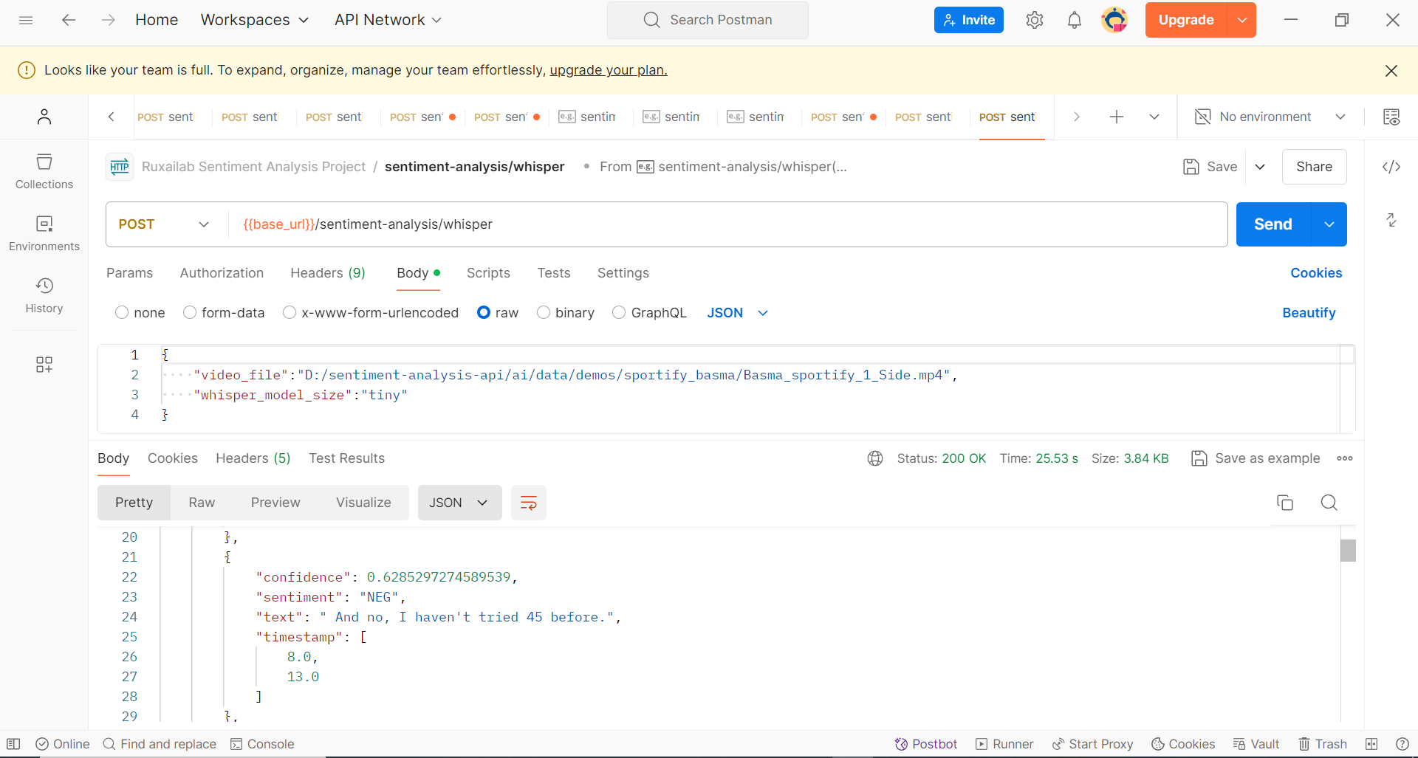



Flask App

Slide 18
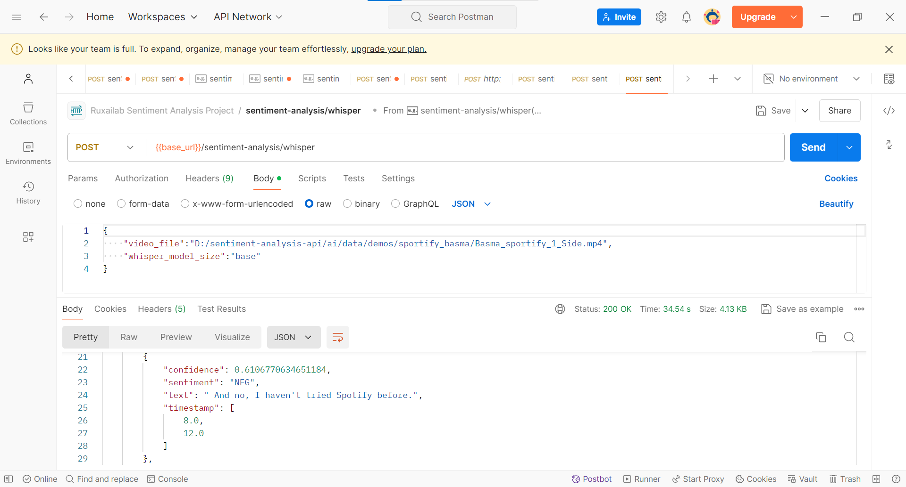

Flask App

Slide 19


Flask App

Slide 20


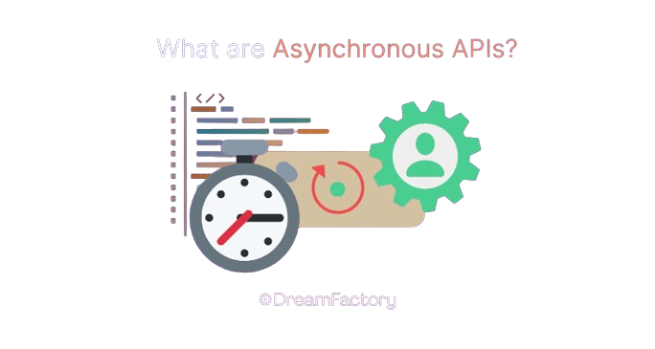


Flask App
Completed Tasks:
Sentiment Analysis End point with option to select whisper model size
Pending Tasks:
API Documentation for the endpoint
Check Async Requests for large videos (Async API)

Slide 21


Docker
I have to Study Docker !!!

Slide 22


Docker
Finally, I understood
Docker :D
Resources:
Docker Crash Course (you tube) [link]

Slide 23

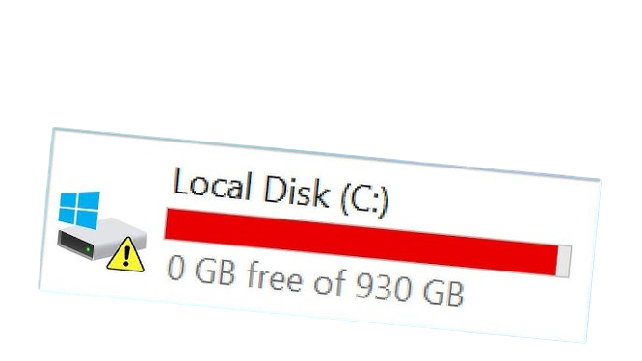


Docker
Challenges:
Docker issues on Windows
Solution:
Using Linux System :D

Slide 24


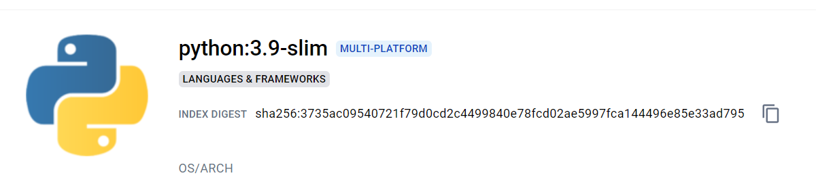

Docker
Challenges:
Docker issues on Windows
Parent Image
Options:

Slide 25



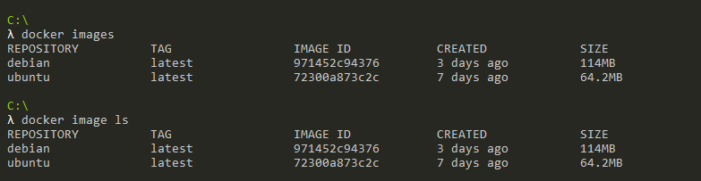

Docker
Challenges:
Docker issues on Windows
Parent Image
Options:

Slide 26

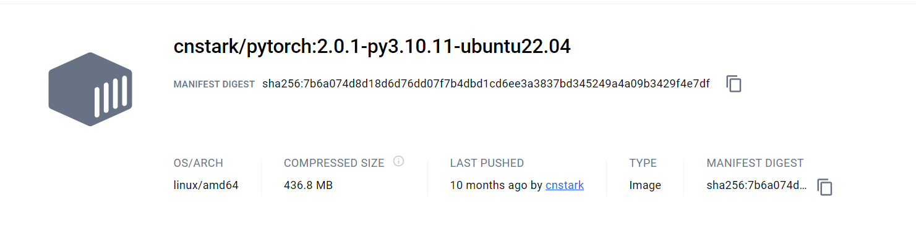
Docker
80% is CUDA libraries !!!
Use CPU Version :D

Slide 27
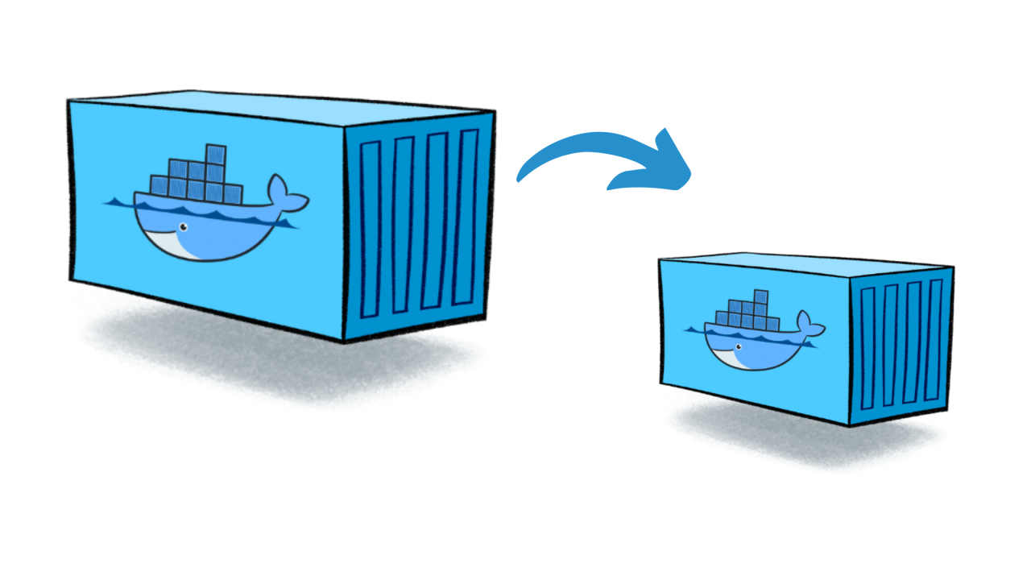
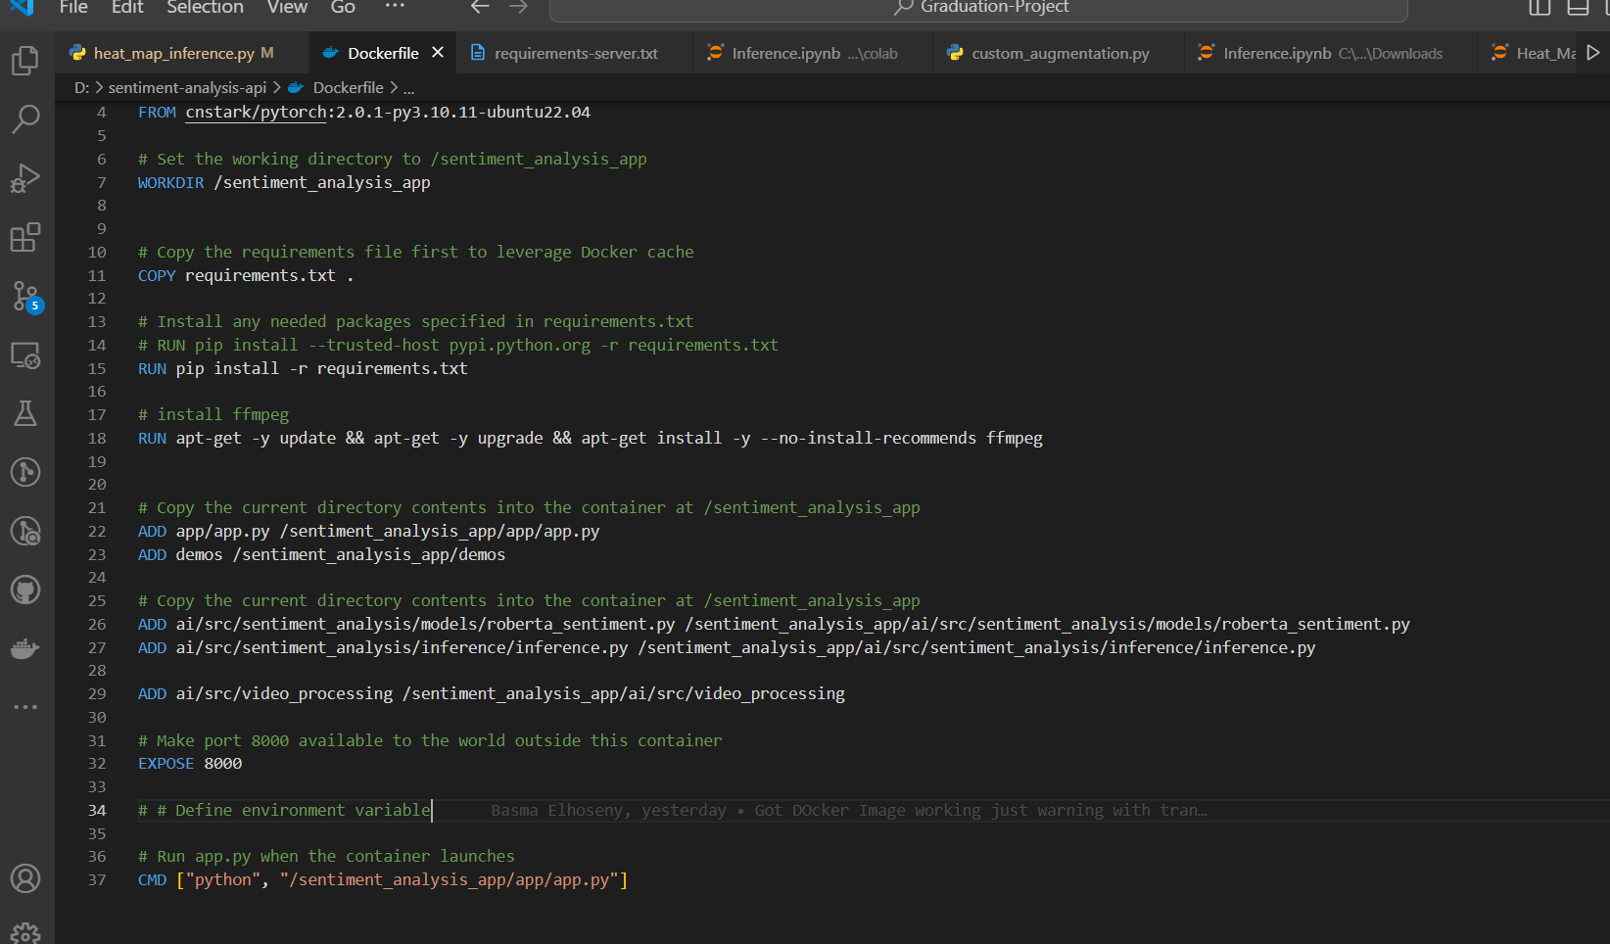
Docker Optimization

Slide 28
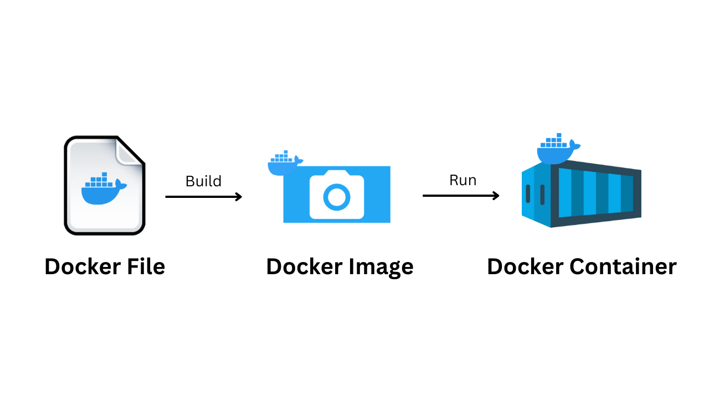
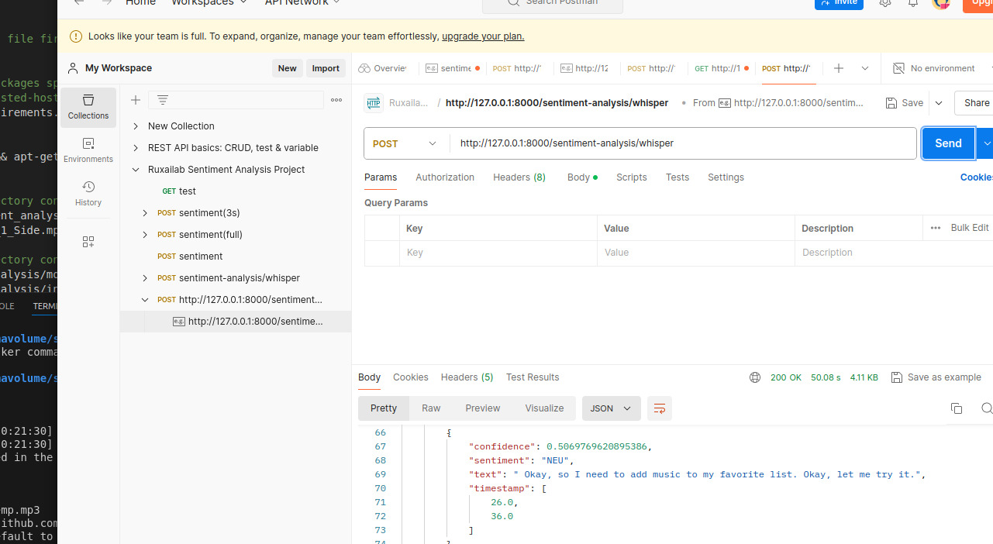
Docker (result)

Slide 29



Cloud Provider
Deploy the Docker Image to Cloud Provider
Easy ??!

Slide 30


Coding
Files:
Video2Audio: video_2_audio.py
Whisper Model: whisper_transcript.py
Sentiment Model: roberta_predict.py
Pipeline: inference.py
Flask App: App
Docker Image: Dockerfile
Check More Files [here]

Slide 31
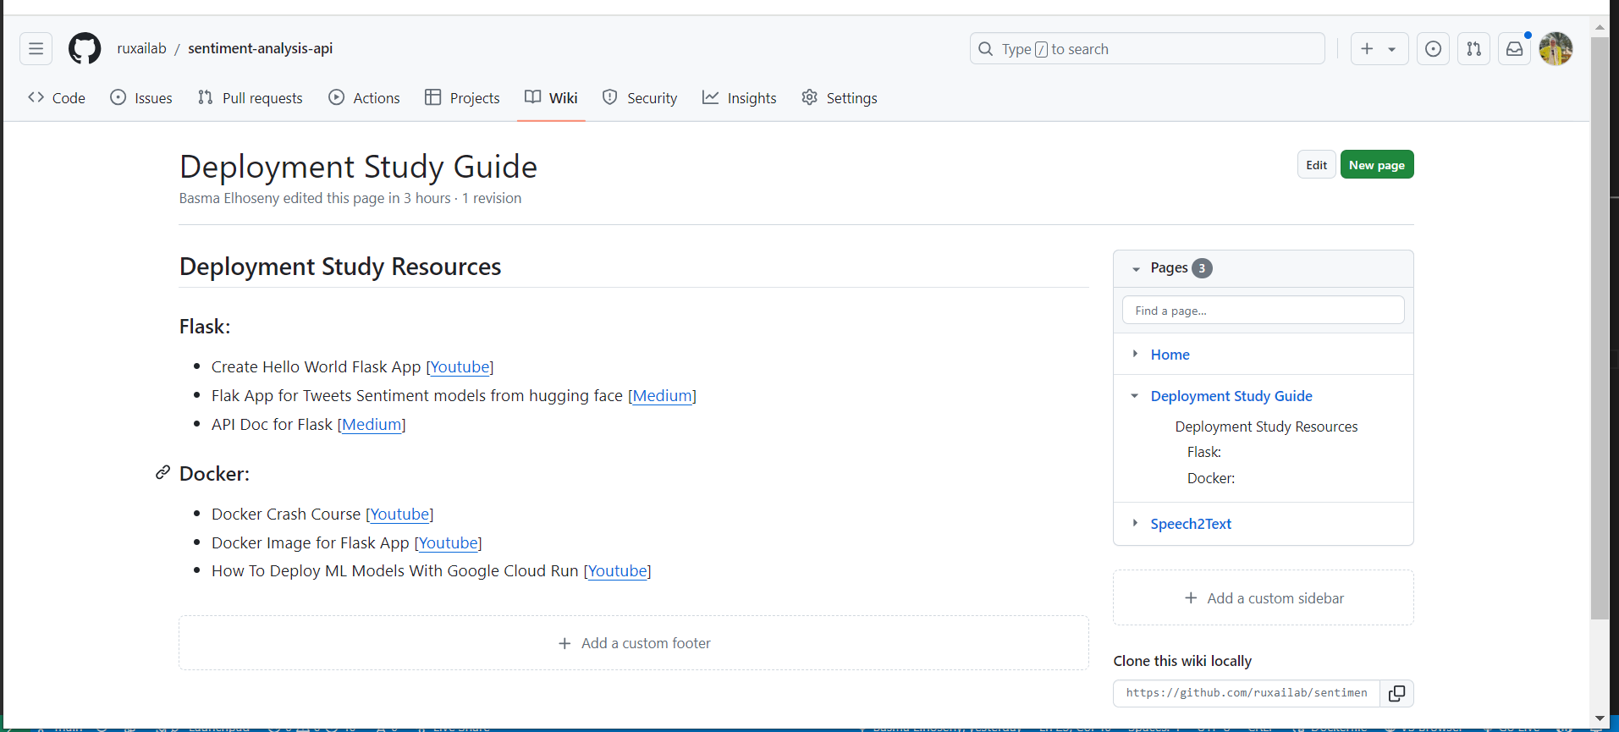
Wikki (Deployment Resources)
We will find something to Document

Slide 32

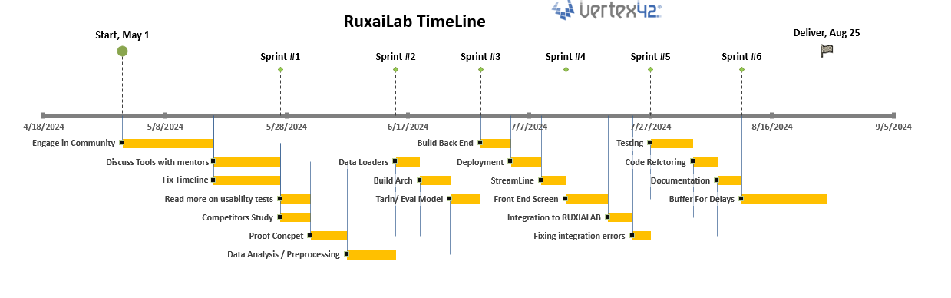
Timeline
So Far, We are following Timeline

Slide 33

New Tasks
New Tasks:
Using link for video file from firebase not locally
Try deploying Docker Image to a cloud provider
Check for Async request
UI Design for the feature integration
Front End Implementation
Documentations
API
Wikki

Slide 34

Questions To Mentors
Questions:
One-sided Video Analysis
Saving audio file to the firebase for faster inference (I think ☺)
Do we need stream-lite
How will we integrate the api to RuxaiLab
Ideas about what to document for easier use by contributors
Any Docs Required for the Mid-Term Evaluation

Slide 35


Feedback
Give me your Feedback about progress till now &
Next Steps
Small notes = Great Work

Slide 36





Thank you
Any Questions?
BasmaElhoseny01
basmaelhoseny01
basmaelhoseny6@gmail.com

